Slide 1
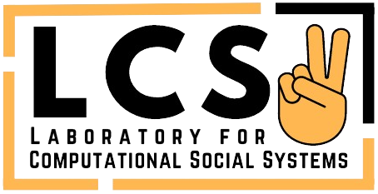

Don’t Underestimate the Power of Small Language Models!
Tanmoy Chakraborty
Associate Professor
Indian Institute of Technology Delhi (IIT Delhi), India
Web: tanmoychak.com, Lab: lcs2.in
12th Advanced Summer School on NLP (IASNLP), IIIT Hyderabad, July 2, 2024

Slide 2
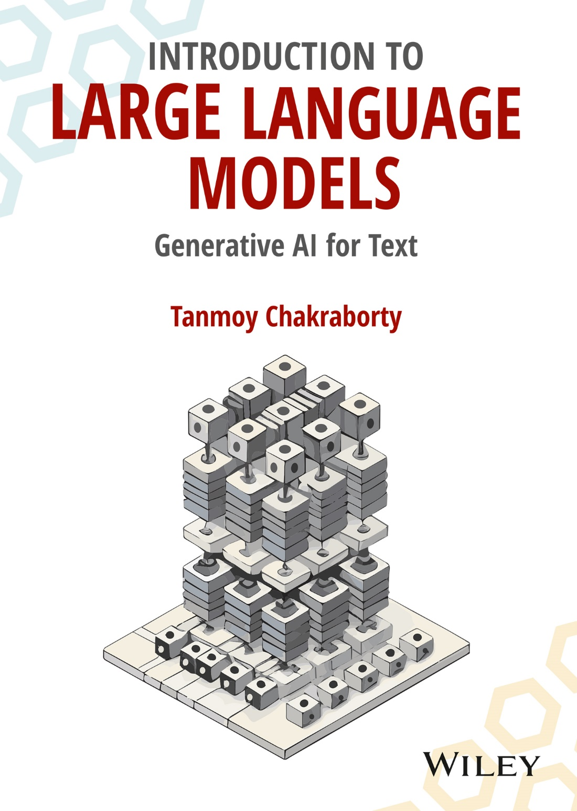
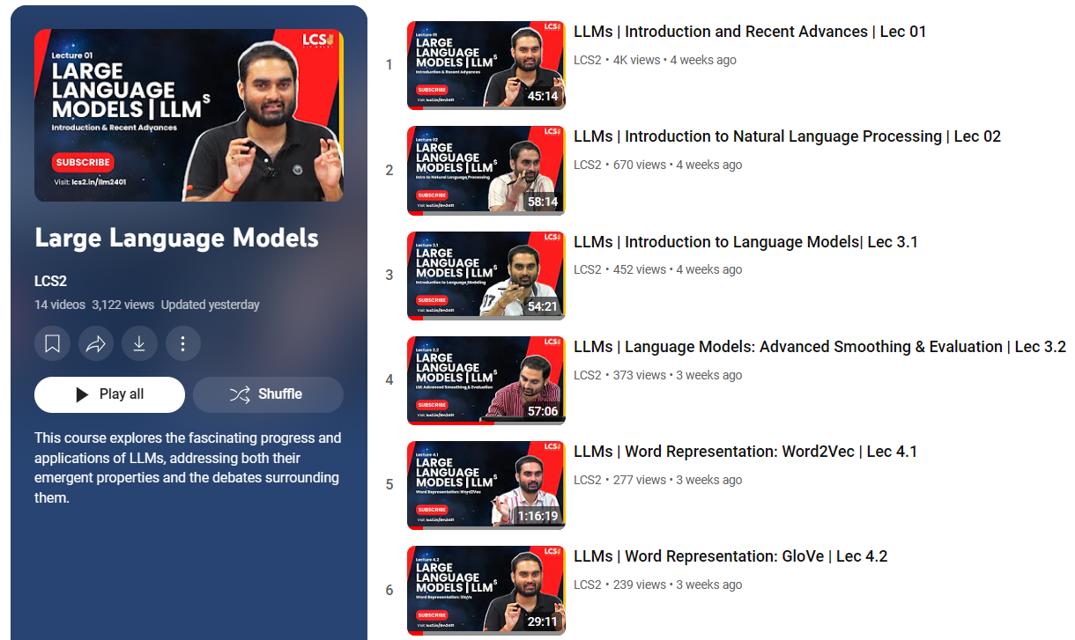
https://www.amazon.in/dp/936386474X/
Lecture slides
Lecture recording
Comprehensive exercise and solutions
Links to important repositories
Links to seminal research papers
38K views, ~6k subscriptions
https://www.youtube.com/@lcs2575/playlists

Slide 3
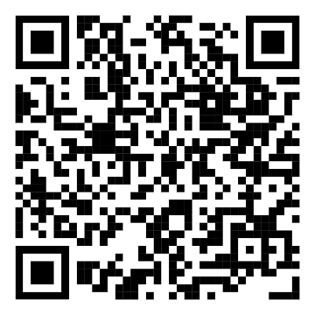
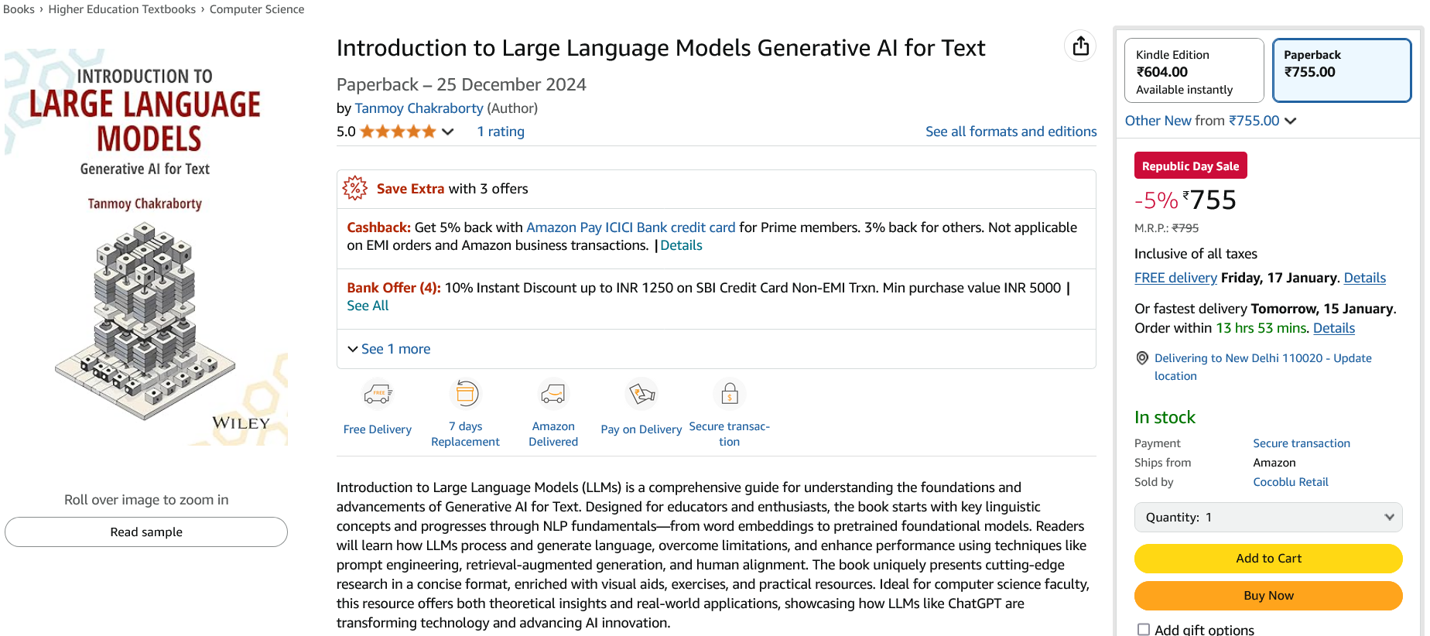
https://www.amazon.in/dp/936386474X/

Slide 4
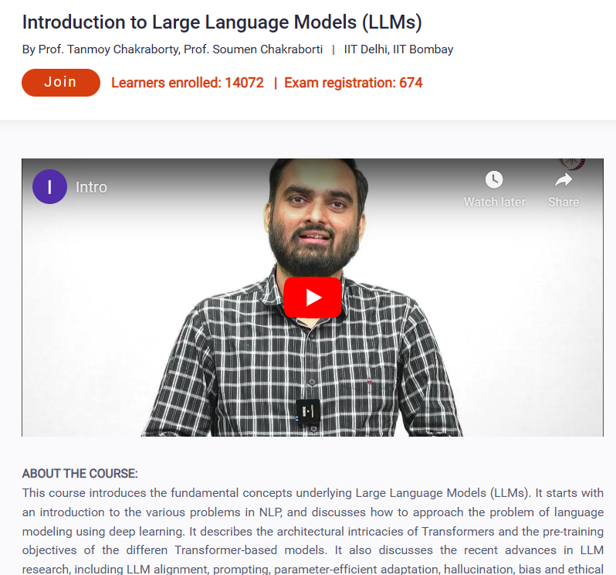
Today is the last registration date
NPTEL Swayam
January, 2025
https://onlinecourses.nptel.ac.in/noc25_cs45/preview

Slide 5
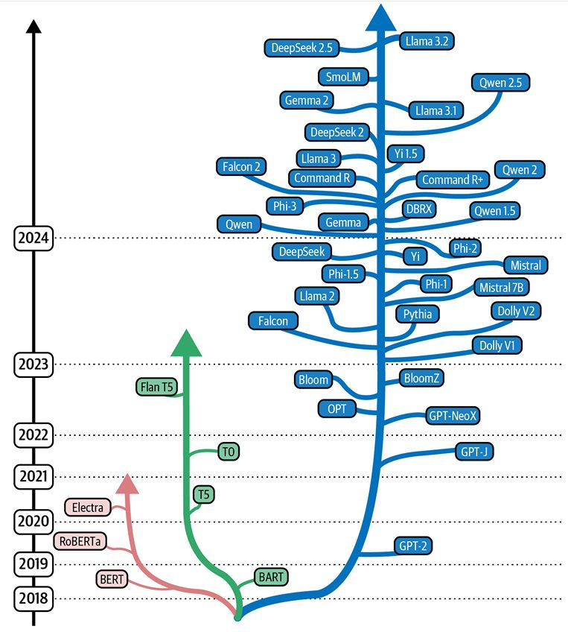
LMs with wide range of scales
Transformer-based LLMs have transformed how we interact with technology – from QA to creative writing.
Open-source LMs are now available for a wide range of scales: Phi-1.5 (1.3B), Gemma 2 (2B), …, OPT(175B), BLOOM(176B), Llama 3.1 (405B).
Image Source: Tweet by Omar Sanseviero

Slide 6
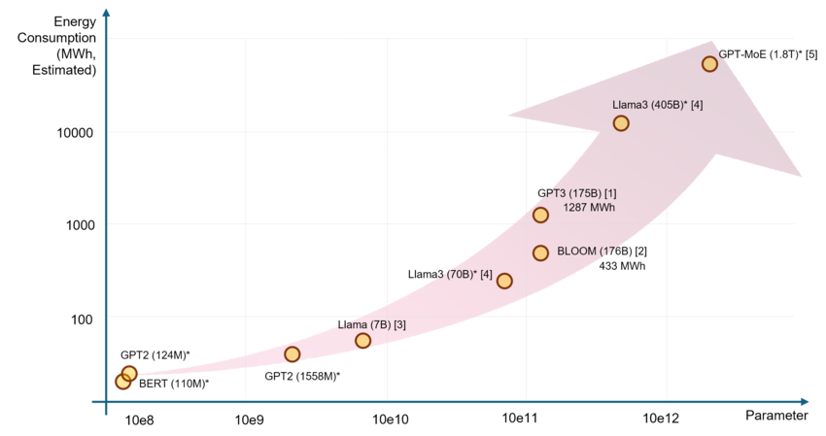
Scaling up isn’t always the solution
Bigger models don’t just mean better results – they also mean higher energy consumption, increased costs, and access limitations.
Image Source: Li, Mughees, Chen, Li, Yunwei. The Unseen AI Disruptions for Power Grids: LLM-Induced Transients. ArXiv 2024

Slide 7
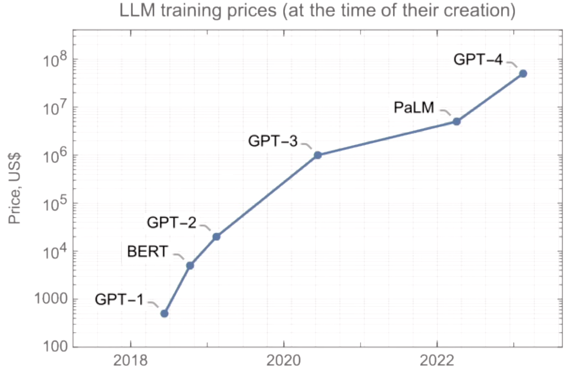
Scaling up isn’t always the solution
Bigger models don’t just mean better results – they also mean higher energy consumption, increased costs, and access limitations.
Image Source: https://youtu.be/_6R7Ym6Vy_I?si=6RVLmJe9lbjghQGG

Slide 8
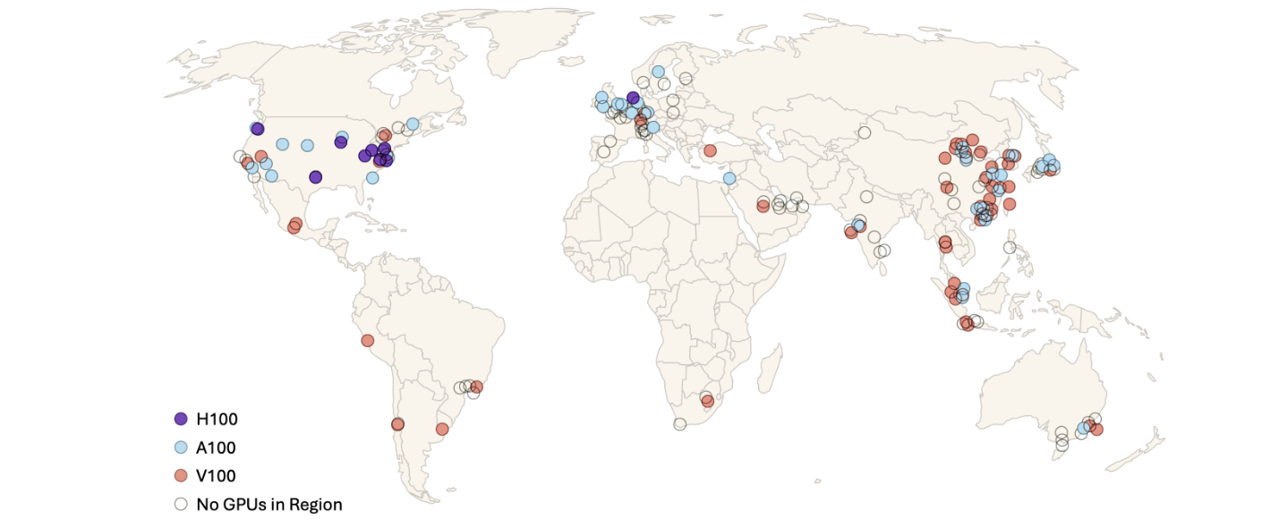
Imagine a world where models work everywhere!
Need models to perform well on limited hardware, low-bandwidth connections, and in low-resource languages.
Approximate locations of public cloud regions and the most advanced GPU type available in each region
Image Source: Lehdonvirta, Wú, Hawkins. Compute North vs. Compute South: The Uneven Possibilities of Compute-based AI Governance Around the Globe. AIES 2024

Slide 9
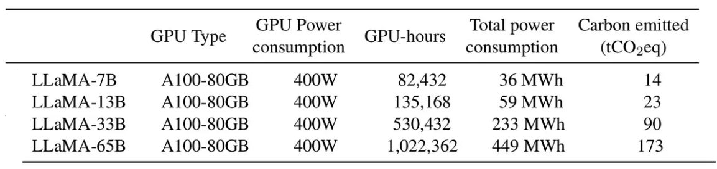
Llama 1 Statistics
https://arxiv.org/pdf/2302.13971

Slide 10
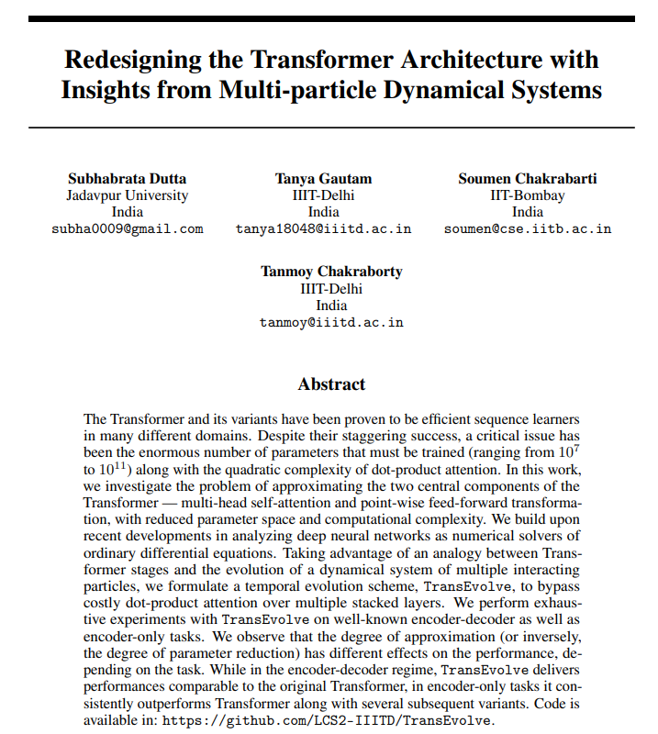
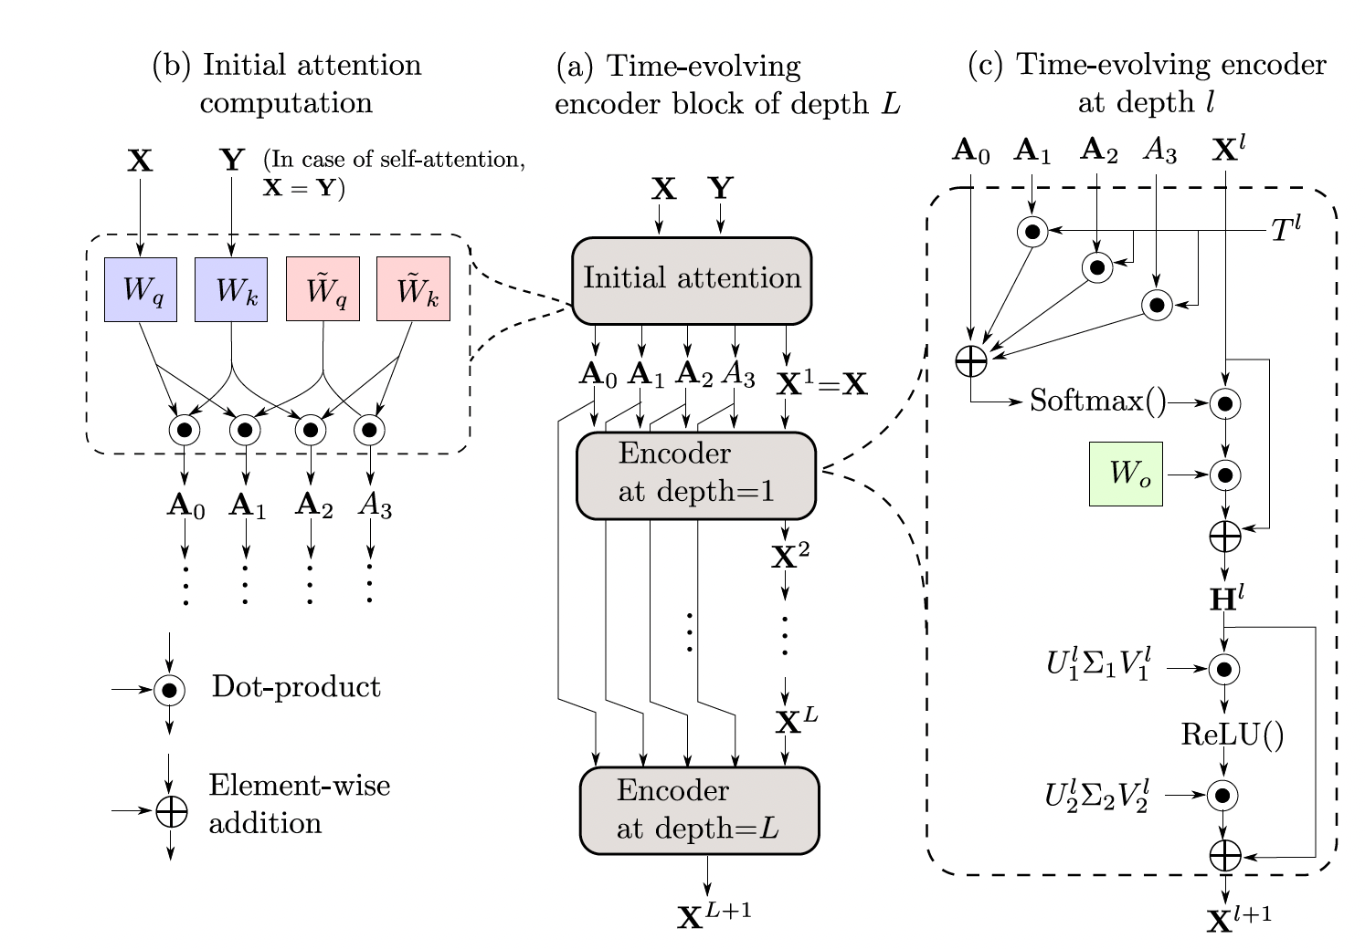
TransEvolve
NeurIPS’21 - Spotlight
Deep neural networks as numerical solvers of ordinary differential equations
On all the encoder-only tasks, TransEvolve outperforms Transformer, as well as several strong baselines, with 50% fewer trainable parameters and more than 3× training speedup.

Slide 11
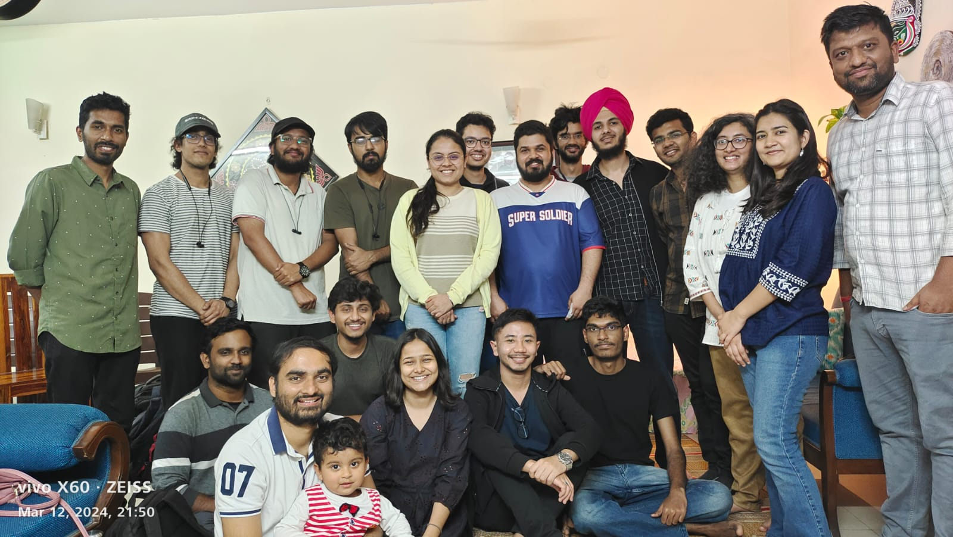

















Laboratory for Computational Social Systems (LCS2), IIT Delhi
http://lcs2.in
@lcs2lab
Thanks to our sponsors
http://lcs2.iiitd.edu.in
@lcs2-iiitd
@lcs2iiitd
@lcs2iiitd

Slide 12
LCS2’s Focus: Economical, Adaptable and Interpretable LMs that can reason faithfully
Economical
Interpretable
Adaptable
Economical – How can we achieve powerful performance with fewer resources?
Adaptable – How do we make models generalize to new and low-resource domains?
Interpretable – Can we understand ‘why’ and ‘how’ they make predictions? Can we control them?
IBM, Meta, Microsoft, DRDO
JPMC, Adobe
Google

Slide 13
Small Language Model (SLM) is All You Need !!!
Designing efficient small language models
Teaching existing small language models to coordinate

Slide 14
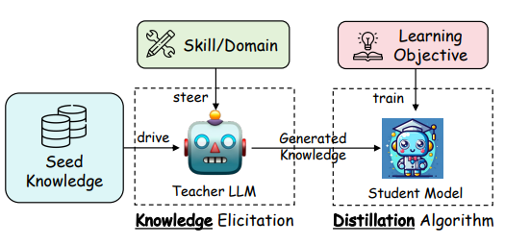
Knowledge Distillation (KD)
Teachers gather real-world knowledge through pre-training and task-specific knowledge from task-specific seed knowledge.
Image reference: Xu et al., 2024

Slide 15
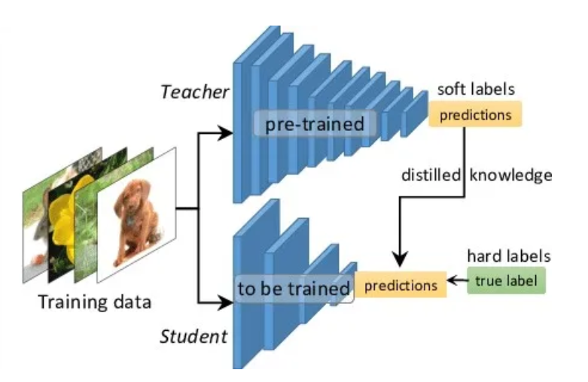
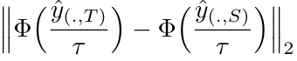
Knowledge Distillation (KD): Types
Hinton et al., 2015
Teacher model generate soft labels (logits)
Teacher generated logits used to fine-tune the student
Notes:
Knowledge distillation (KD) was popularized by Hinton et al., 2015 to distil knowledge from large models to smaller models.
The student model learns by imitating the teacher model on output distribution

Slide 16
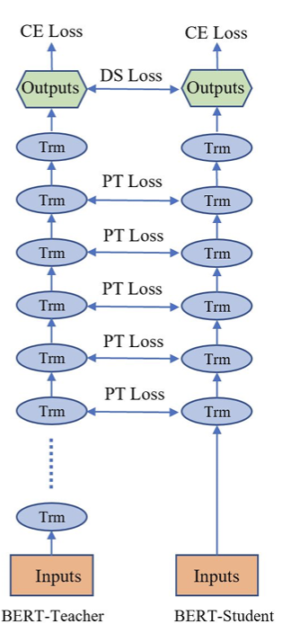
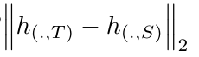
Knowledge Distillation (KD): Types
Hinton et al., 2015
Teacher model generate soft labels (logits)
Distance between layer-wise representations used to enforce student model to imitate the teacher
Teacher generated logits used to fine-tune the student
Sun et al., 2019
Notes:
Knowledge distillation (KD) was popularized by Hinton et al., 2015 to distil knowledge from large models to smaller models.
The student model learns by imitating the teacher model on output distribution

Slide 17
Limitations of Vanilla KD
Knowledge sharing is unidirectional, i.e., teacher is not aware of student’s capacity
Image reference: Xu et al., 2024

Slide 18



Meta Knowledge Distillation (MetaKD)
Unimodal knowledge distillation for model compression (ICLR, 2024)
Feature-based knowledge distillation
Student-aware meta knowledge distillation
Teacher-student competitive knowledge distillation
Cross-modal knowledge distillation
Empowering language models with mental images
Knowledge distillation from black-box multimodal teachers
Ayan Sengupta

Slide 19
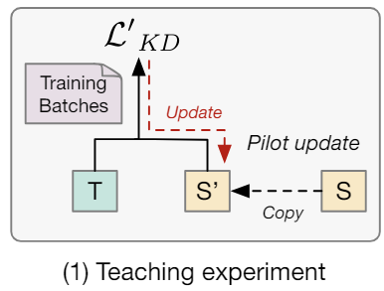
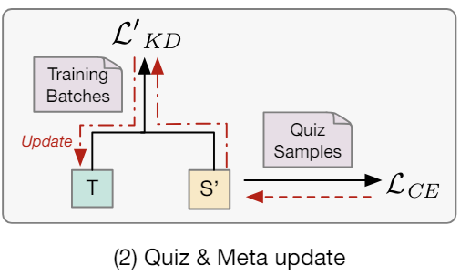
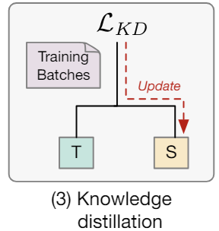
Student-Aware Meta Distillation: Learning to teach
Zhou et al. 2021
The teacher is aware of the student’s capacity.
The teacher is optimized for distillation.
Limitations
1. Fine-tuning a large teacher model (>10B) is infeasible
2. Teacher should set a strong benchmark for the student, not just narrowing down the teacher-student gap

Slide 20
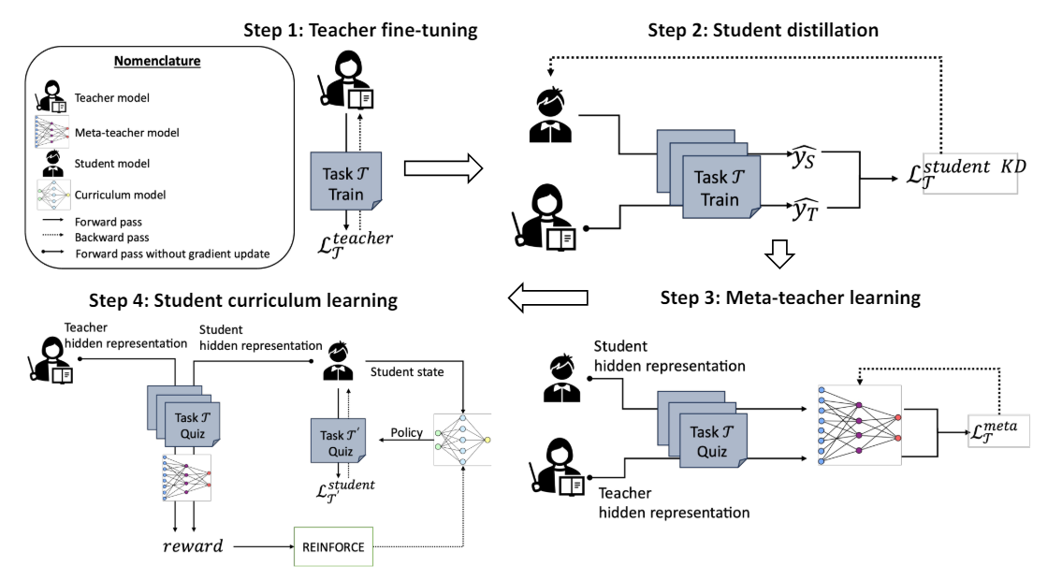
Meta-Policy Knowledge Distillation (MPDistil)
A healthy competition between the teacher and student can encourage both the models to perform better.
A better teacher can set a higher benchmark for the student, enhancing student’s performance.
The student can devise better learning strategy (curriculum) to perform better than the teacher.
Sengupta, Dixit, Akhtar, Chakraborty. A Good Learner Can Teach Better: Teacher-Student Collaborative Knowledge Distillation. ICLR 2024.

Slide 21
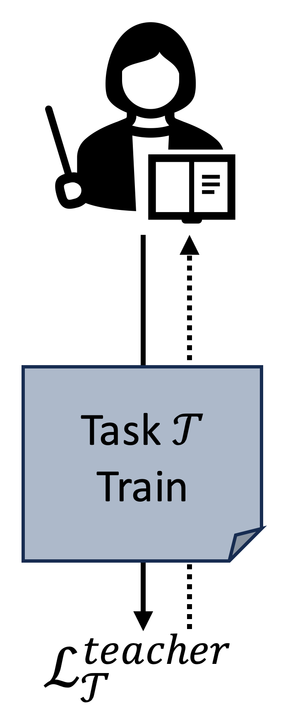
Step 1: Teacher Fine-tuning
1. Teacher Fine-tuning
Notes:
Devise a meta-teacher T′ to jointly optimize both teacher and student performances
Unlike Zhou et al., we don’t need a full fine-tuned meta-teacher. Even a discriminator model can act as meta-teacher.
Meta-teacher is trained on a separate quiz dataset (sample of training)
The meta-teacher obtains the hidden states for each quiz input from both the teacher T and the student S models and computes the meta outputs
Under the competitive loss, the meta teacher maximizes the teacher-student margin of outputs, along with minimizing the loss for the teacher.
Under the collaborative loss formulation, the meta teacher minimizes the joint loss of teacher and student

Slide 22
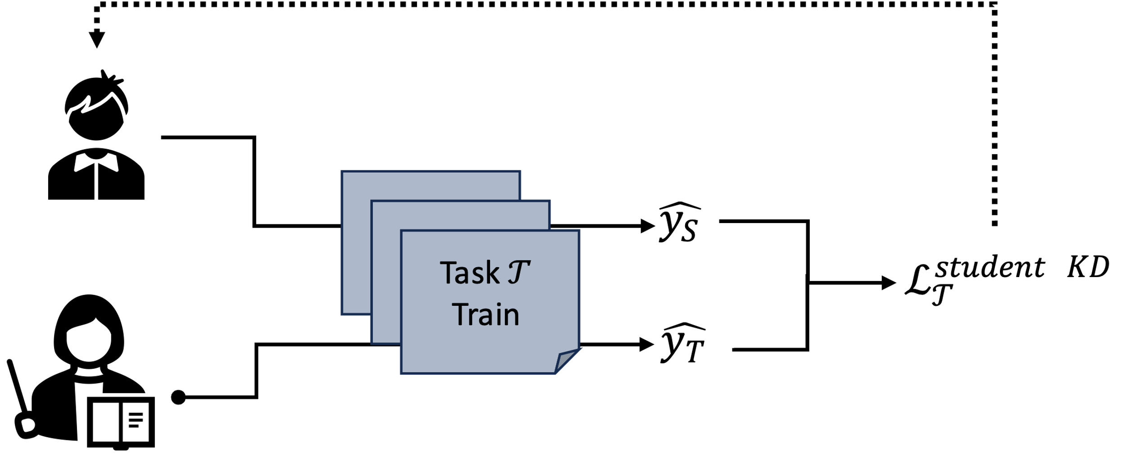
Step 2: Student Distillation
1. Teacher Fine-tuning
2. Student Distillation
Notes:
Devise a meta-teacher T′ to jointly optimize both teacher and student performances
Unlike Zhou et al., we don’t need a full fine-tuned meta-teacher. Even a discriminator model can act as meta-teacher.
Meta-teacher is trained on a separate quiz dataset (sample of training)
The meta-teacher obtains the hidden states for each quiz input from both the teacher T and the student S models and computes the meta outputs
Under the competitive loss, the meta teacher maximizes the teacher-student margin of outputs, along with minimizing the loss for the teacher.
Under the collaborative loss formulation, the meta teacher minimizes the joint loss of teacher and student

Slide 23
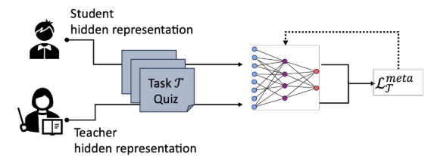
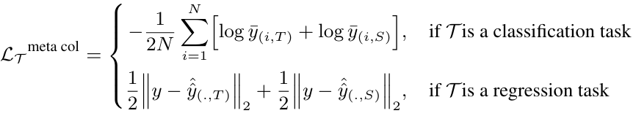
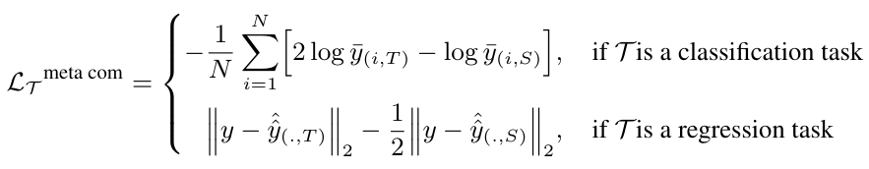
Step 3: Meta-teacher Learning
1. Teacher Fine-tuning
2. Student Distillation
3. Teacher Meta Learning
(on a quiz dataset)
Collaborative Loss
Competitive Loss
Intuition: The meta-teacher obtains the hidden states from both teacher and student and creates a healthy competition between the models.
Notes:
Devise a meta-teacher T′ to jointly optimize both teacher and student performances
Unlike Zhou et al., we don’t need a full fine-tuned meta-teacher. Even a discriminator model can act as meta-teacher.
Meta-teacher is trained on a separate quiz dataset (sample of training)
The meta-teacher obtains the hidden states for each quiz input from both the teacher T and the student S models and computes the meta outputs
Under the competitive loss, the meta teacher maximizes the teacher-student margin of outputs, along with minimizing the loss for the teacher.
Under the collaborative loss formulation, the meta teacher minimizes the joint loss of teacher and student

Slide 24
Step 3: Meta-teacher learning
1. Teacher Fine-tuning
2. Student Distillation
3. Teacher Meta Learning
(on a quiz dataset)
Collaborative Loss
Competitive Loss
Intuition: The meta-teacher obtains the hidden states from both teacher and student and creates a healthy competition between the models.
Notes:
Devise a meta-teacher T′ to jointly optimize both teacher and student performances
Unlike Zhou et al., we don’t need a full fine-tuned meta-teacher. Even a discriminator model can act as meta-teacher.
Meta-teacher is trained on a separate quiz dataset (sample of training)
The meta-teacher obtains the hidden states for each quiz input from both the teacher T and the student S models and computes the meta outputs
Under the competitive loss, the meta teacher maximizes the teacher-student margin of outputs, along with minimizing the loss for the teacher.
Under the collaborative loss formulation, the meta teacher minimizes the joint loss of teacher and student

Slide 25
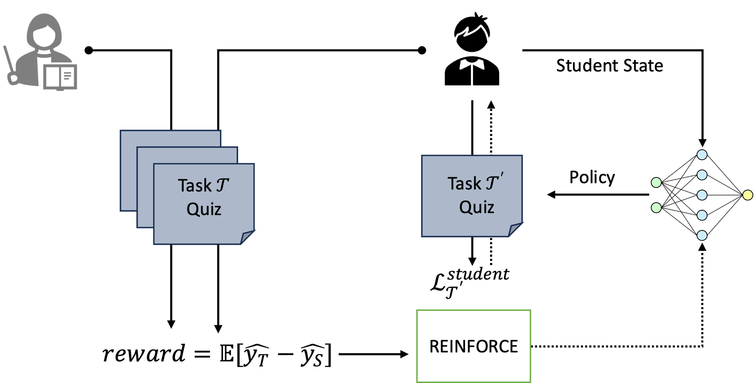
Step 4: Student Curriculum Learning
1. Teacher Fine-tuning
2. Student Distillation
3. Teacher Meta Learning
(on a quiz dataset)
4. Student Curriculum Learning
Why Curriculum Learning in KD?
In real world, a student might aim to improve her understanding of Physics by studying selected concepts from Mathematics.
Notes:
Devise a meta-teacher T′ to jointly optimize both teacher and student performances
Unlike Zhou et al., we don’t need a full fine-tuned meta-teacher. Even a discriminator model can act as meta-teacher.
Meta-teacher is trained on a separate quiz dataset (sample of training)
The meta-teacher obtains the hidden states for each quiz input from both the teacher T and the student S models and computes the meta outputs
Under the competitive loss, the meta teacher maximizes the teacher-student margin of outputs, along with minimizing the loss for the teacher.
Under the collaborative loss formulation, the meta teacher minimizes the joint loss of teacher and student

Slide 26
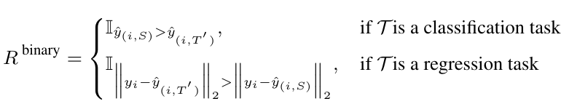
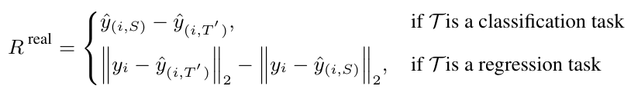
Step 4: Student Curriculum Learning
1. Teacher Fine-tuning
2. Student Distillation
3. Teacher Meta Learning
(on a quiz dataset)
4. Student Curriculum Learning
Competing student tries to beat the teacher
A policy network selects optimal curriculum to fine-tune the student by maximizing the reward
Notes:
Devise a meta-teacher T′ to jointly optimize both teacher and student performances
Unlike Zhou et al., we don’t need a full fine-tuned meta-teacher. Even a discriminator model can act as meta-teacher.
Meta-teacher is trained on a separate quiz dataset (sample of training)
The meta-teacher obtains the hidden states for each quiz input from both the teacher T and the student S models and computes the meta outputs
Under the competitive loss, the meta teacher maximizes the teacher-student margin of outputs, along with minimizing the loss for the teacher.
Under the collaborative loss formulation, the meta teacher minimizes the joint loss of teacher and student

Slide 27
Step 4: Student Curriculum Learning
1. Teacher Fine-tuning
2. Student Distillation
3. Teacher Meta Learning
(on a quiz dataset)
4. Student Curriculum Learning
Competing student tries to beat the teacher
A policy network selects optimal curriculum to fine-tune the student by maximizing the reward
Notes:
Devise a meta-teacher T′ to jointly optimize both teacher and student performances
Unlike Zhou et al., we don’t need a full fine-tuned meta-teacher. Even a discriminator model can act as meta-teacher.
Meta-teacher is trained on a separate quiz dataset (sample of training)
The meta-teacher obtains the hidden states for each quiz input from both the teacher T and the student S models and computes the meta outputs
Under the competitive loss, the meta teacher maximizes the teacher-student margin of outputs, along with minimizing the loss for the teacher.
Under the collaborative loss formulation, the meta teacher minimizes the joint loss of teacher and student

Slide 28
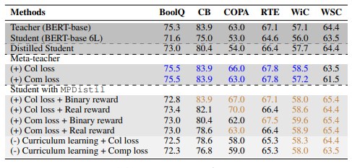
Empirical Evidences of Meta-Policy KD
Distillation results for BERT-base (110M) model
Takeaways:
A meta-teacher trained on collaborative/competitive loss can outperform the original fine-tuned teacher.
Student distilled in a competitive manner can even outperform the teacher on the downstream tasks.
A learned curriculum can help identify the gaps in student’s learning and help it in gathering a generalized view of different concepts.

Slide 29
Other Findings
Can better learners teach better?
An improved meta-teacher can positively impact the performance of the student model. The higher the improvement for meta-teacher, the better the distilled student model gets.
How does higher student reward impact student’s performance?
Higher rewards can encourage students to perform better. Expected binary reward is always higher than the expected real reward.
How does a student select learning curricula?
Curriculum model draws balance between exploration and exploitation to derive the optimal curriculum for the student model to maximize its performance. On high performing tasks, the model explores heavily at the beginning, before exploiting the same tasks in the consecutive curriculums. Further, we observe the importance of task sequencing in the curriculums for effective knowledge distillation.

Slide 30
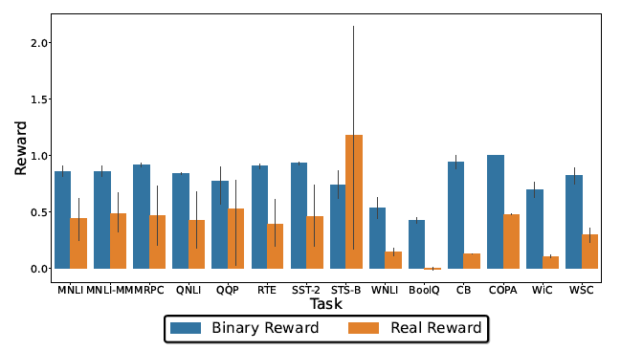
How Does Different Reward Impact Student Models?
Takeaways:
Higher the reward, better the student gets
Better performance comes when the student model explores diverse tasks at beginning and exploit them subsequently.
Not just the number of different tasks matter in a curriculum, but the sequence to which these tasks are passed to the student also matters

Slide 31
Limitations of MPDistil
MPDistil uses a layer-wise distance minimization between the teacher and student (like Sun et al., 2019), which can only be used if the models belong to the same family.
MPDistil, like any existing unimodal KD methods, assume homogeneity in teacher and student modalities.
Unimodal KD techniques fail to assimilate complex multi-modal abstractions to student models

Slide 32
Meta knowledge Distillation
Unimodal knowledge distillation for model compression (ICLR, 2024)
Feature-based knowledge distillation
Student-aware meta knowledge distillation
Teacher-student competitive knowledge distillation
Cross-modal knowledge distillation
Empowering language models with mental images
Knowledge distillation from black-box multimodal teachers
Ayan Sengupta

Slide 33
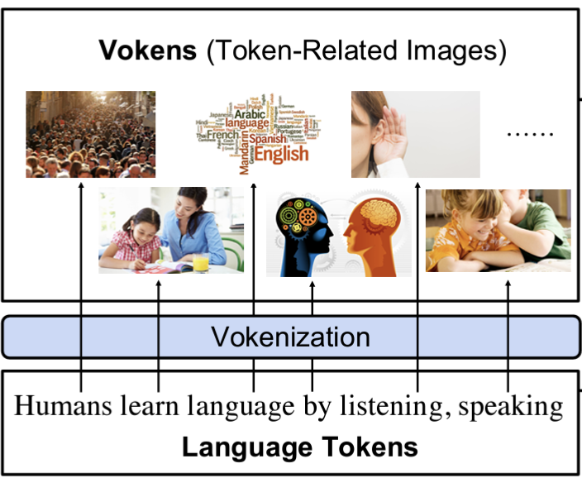
Cross-Modal Knowledge Distillation
Several large pre-trained models such as GPT-4o and Gemini are multimodal models. These models can be distilled to modality-specific smaller models.
A vision-text teacher model can help a text-only student model to formulate mental images.
Image reference: Tan and Bansal 2020

Slide 34
Distilling Black-Box Multimodal Models
Use a meta-teacher (like MPDistil) to teach the student models with black-box teachers.
Use appropriate alignment modules to align the abstractions in different modality spaces.

Slide 35
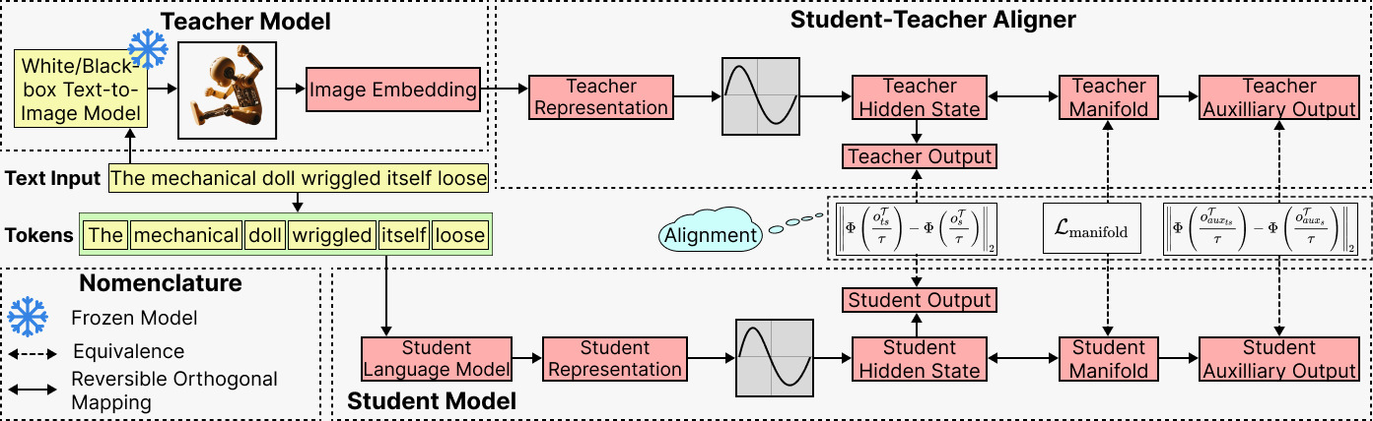
ARMADA: Alignment-induced Cross-modal KD
Given a text input, image embedding is obtained from the black-box teacher model
Notes:
An equivalence between the teacher and student manifolds ensure equivalence in the output spaces
Homeomorphism ensures that the teacher and student model representations are topologically similar
A student model homeomorphic to a multimodal teacher model is well-regularized and can avoid overfitting in the original student modality

Slide 36
ARMADA: Alignment-induced Cross-modal KD
Text input is passed to student language model for obtaining outputs and manifold projection
Notes:
An equivalence between the teacher and student manifolds ensure equivalence in the output spaces
Homeomorphism ensures that the teacher and student model representations are topologically similar
A student model homeomorphic to a multimodal teacher model is well-regularized and can avoid overfitting in the original student modality

Slide 37
ARMADA: Alignment-induced Cross-modal KD
A Student-Teacher (TS) Aligner is used to obtain meta outputs and TS manifold projection
Notes:
An equivalence between the teacher and student manifolds ensure equivalence in the output spaces
Homeomorphism ensures that the teacher and student model representations are topologically similar
A student model homeomorphic to a multimodal teacher model is well-regularized and can avoid overfitting in the original student modality

Slide 38
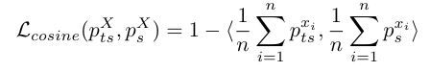
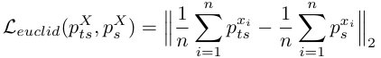
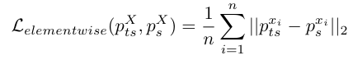
ARMADA: Alignment-induced Cross-modal KD
Alignments help the student model learn abstractions from the teacher modality as well as regularize the student outputs
Notes:
An equivalence between the teacher and student manifolds ensure equivalence in the output spaces
Homeomorphism ensures that the teacher and student model representations are topologically similar
A student model homeomorphic to a multimodal teacher model is well-regularized and can avoid overfitting in the original student modality

Slide 39
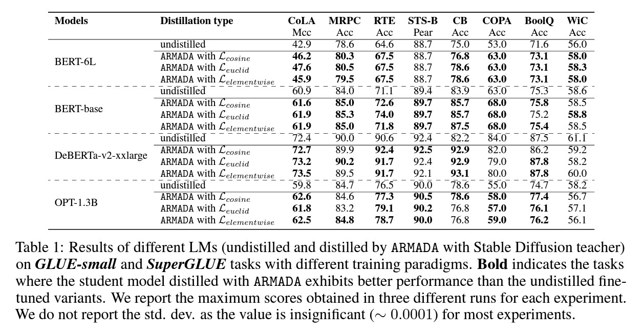
Empirical Evidences of Cross-Modal Distillation
Takeaways:
ARMADA can improve the performance of an undistilled fine-tuned BERT-base model by over 2% across different NLU tasks.
Even large pre-trained models such as DeBERTa and OPT (>1B) can be improved with cross-modal KD.

Slide 40
Takeaways
Student-aware fine-tuning for distillation: Vanilla pre-training doesn't inherently distil knowledge; student-aware fine-tuning of the teacher is essential.
Efficiency of meta-teachers: Large models don't need distillation fine-tuning; smaller meta-teachers can suffice.
Teacher performance: Teachers can distil knowledge effectively even with subpar downstream performance.
Teacher-student performance correlation: Improved teacher learning correlates with better student performance.
Reward models' impact: Suitable reward models enhance student performance and distillation effectiveness.

Slide 41
Small Language Model (SLM) is All You Need !!!
Designing efficient small language models
Teaching existing small language models to coordinate

Slide 42
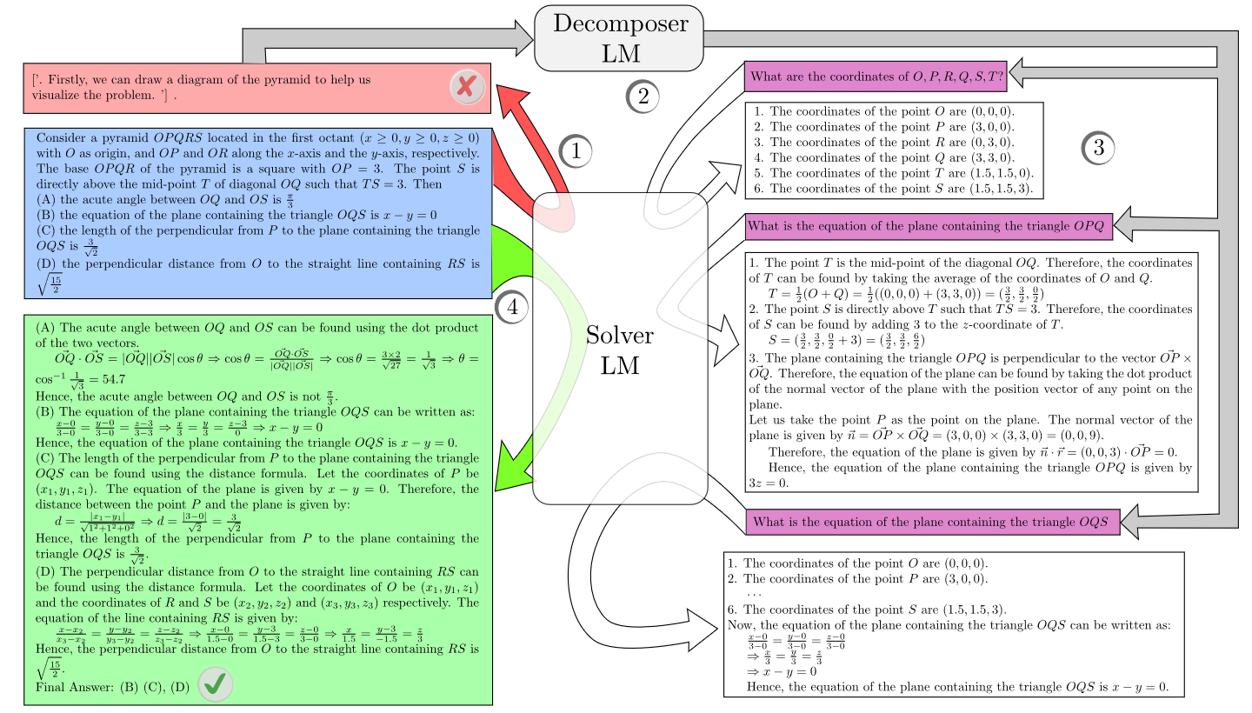
Coordination between SLMs (Decomposer) & LLMs (Solver)
Juneja, Dutta, Chakrabarti, Manchanda, Chakraborty. Small Language Models Fine-tuned to Coordinate Larger Language Models Improve Complex Reasoning. EMNLP 2023

Slide 43
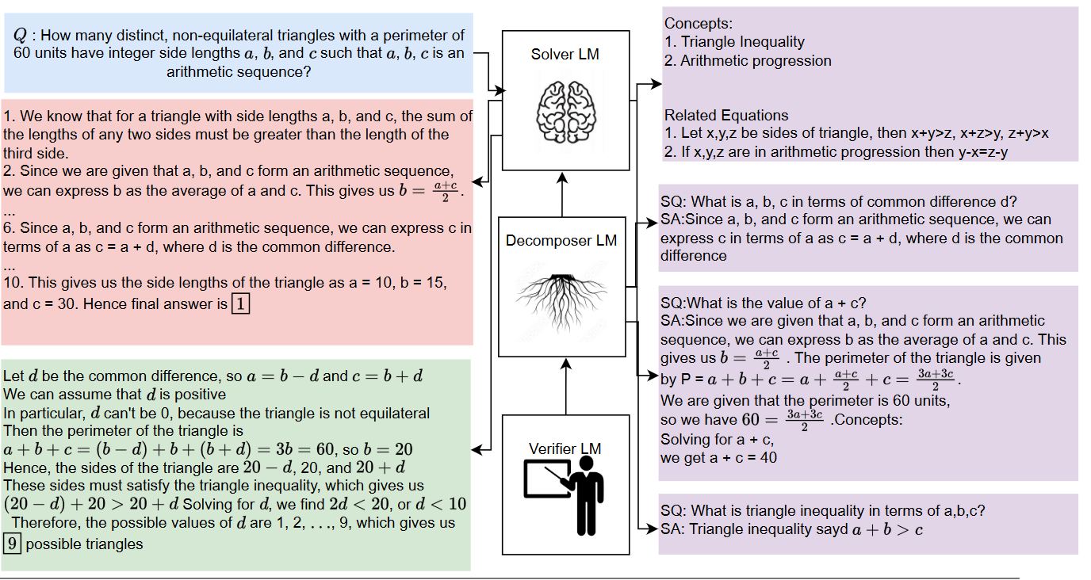
LM²: Language Model Multiplex
Juneja, Dutta, Chakraborty. LM²: A Simple Society of Language Models Solves Complex Reasoning. EMNLP 2024

Slide 44
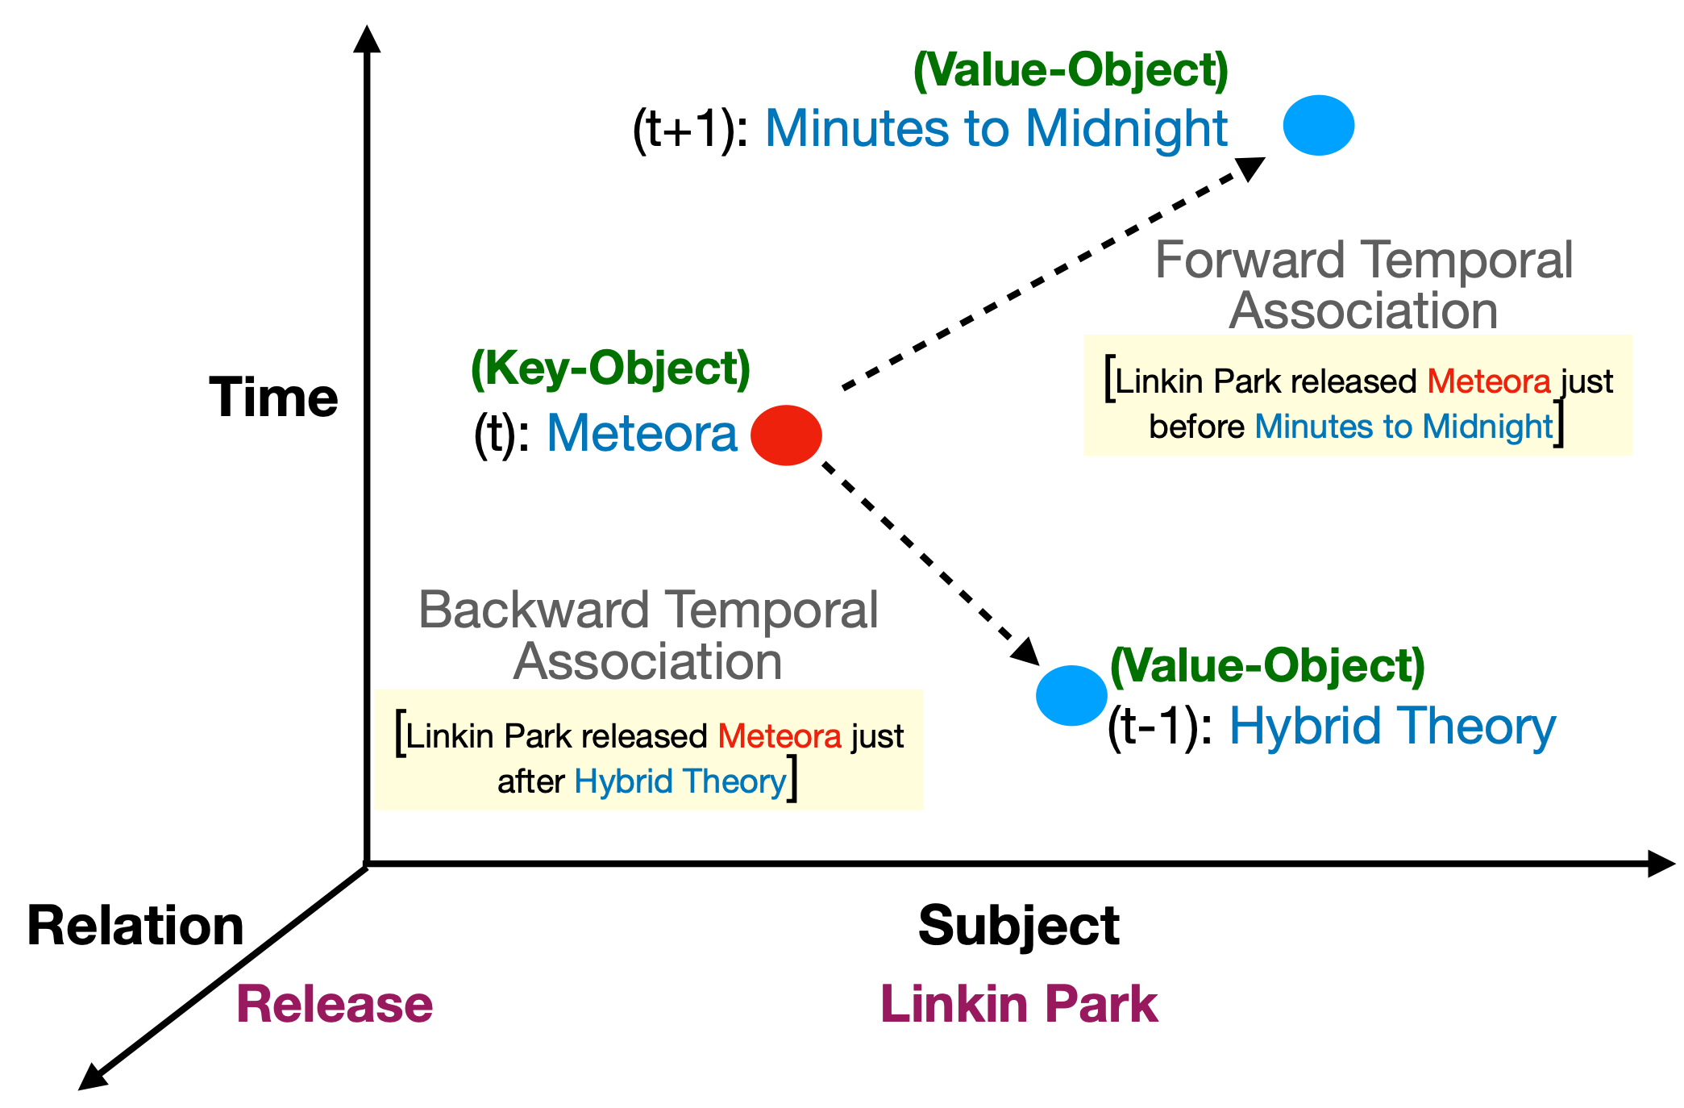
Other projects in reasoning
Spatial, temporal and spatio-temporal reasoning
EMNLP 2023
Multimodal reasoning
Metrics for reasoning evaluation

Slide 45
Towards Building Adaptable Models
Economical
Adoptable
Interpretable

Slide 46
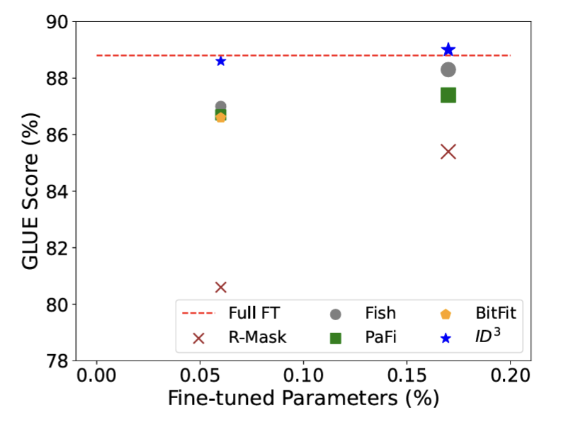
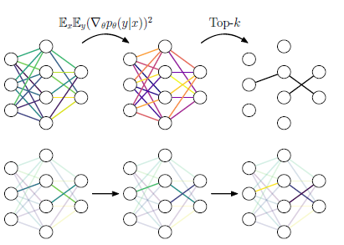
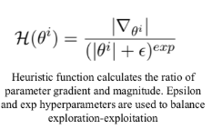
ID3: Adaptive Selective Fine-tuning of LLMs
Agarwal, Ramesh, Sengupta, Chakraborty. Step-by-Step Unmasking for Parameter-Efficient Fine-tuning of Large Language Models. Arxiv 2024
Existing selective PEFT methods (BitFit, FishMask) uses static selection of important parameters for fine-tuning LLMs
Instead, we can adaptively select the top parameters within the same budget and perform exploration-exploitation in the parameter space
Adaptively selective PEFT can perform even better than full fine-tuning as it only selects the important parameters for fine-tuning, therefore, preventing catastrophic forgetting on pre-training knowledge.

Slide 47

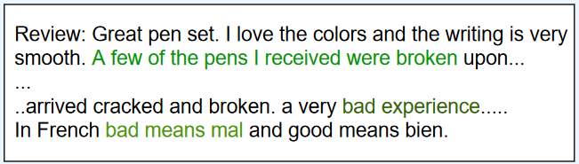
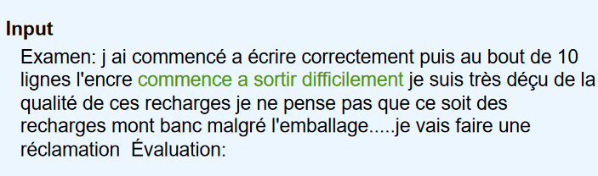
Cross-lingual ICL
Tanwar, Dutta, Borthakur, Chakraborty. Multilingual LLMs are Better Cross-lingual In-context Learners with Alignment. ACL 2023 ( Outstanding Paper Award)
In-context demonstrations and the input are in different languages (cross-lingual).
Cross-lingual In-context Source-Target Alignment
(X-InSTA):
We proposed X-InSTA - a novel and effective prompt construction strategy for cross-lingual ICL.
The in-context demonstration(s) must be semantically-similar to the input (semantic-alignment).
A task aligner need to be appended to the context to connect the source and target label spaces (task-alignment).

Slide 48
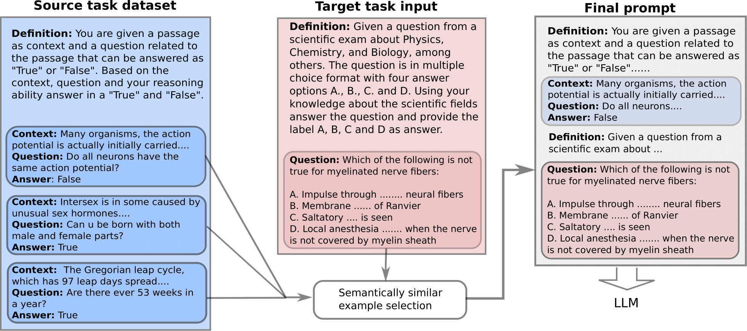
Cross-task ICL
Chatterjee, Tanwar, Dutta, Chakraborty. Language Models can Exploit Cross-Task In-context Learning for Data-Scarce Novel Tasks. ACL 2024
Takeaways:
On average, cross-task prompting improves performance by 107% for LLaMA-2 7B, 18.6% for LLaMA-2 13B and 3.2% for GPT-3.5 over zero-shot settings.
The average performance boost with source tasks which are dissimilar to target tasks is 105.9% for LLaMA-2 7B.
With multiple source tasks, cross-task performance is comparable to in-task prompting.
ICL with demonstrations pseudo-labeled via cross-task prompting lead to comparable performance as gold-labels.
Interpretability Analysis: Cross-task signal transfer within the context is abrupt and happens at later layers of the model.
In-context demonstrations and the input are from different tasks (cross-task).
Input is from a data-scarce novel target task.

Slide 49
Model Interpretability
Economical
Interpretable
Adoptable

Slide 50
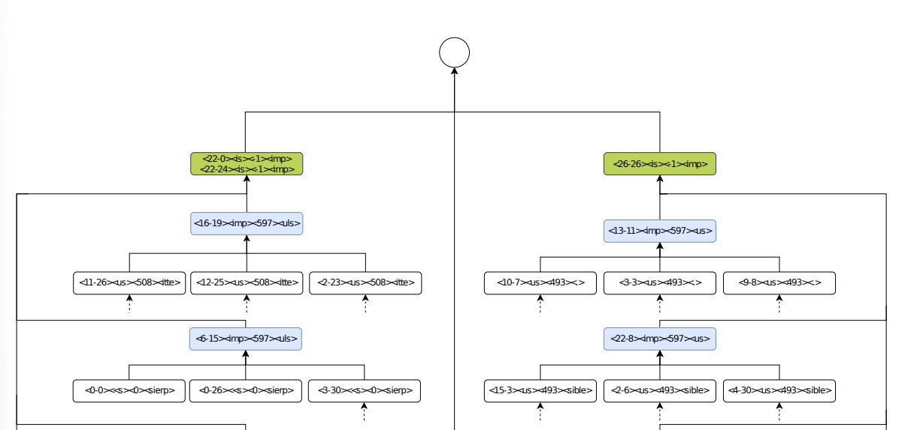
Mechanistic understanding of CoT reasoning
Dutta, Singh, Chakrabarti, Chakraborty. How to think step-by-step: A mechanistic understanding of chain-of-thought reasoning. TMLR 2024.
2 heads, writing <imp> at last residual stream, (is)
4 heads, picking <imp> from input at position 597 (Input context)
Takeaways:
Disentangle the functional fabric of CoT reasoning in LLMs
Multiple different neural pathways are deployed to compute the answer, that too in parallel.
parallel answer generation pathways collect answers from different segments of the input.

Slide 51
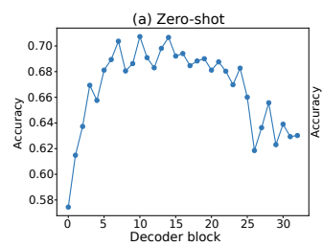


Mechanistic Understanding of CoT reasoning
Dutta, Singh, Chakrabarti, Chakraborty. How to think step-by-step: A mechanistic understanding of chain-of-thought reasoning, TMLR 2024
Fig 1: Token Mixing Analysis
Fig 2: Context-abidance score
Fig 3: Answer Writing heads
Takeaways:
Attention heads perform information movement between ontologically related (or negatively related) tokens. [Fig 1]
We observe a functional rift at the very middle of the LLM (16th decoder block in case of Llama-2 7B). [Fig: 1,2,3]
Prior to this rift, the model primarily assigns bigram associations memorized via pretraining; it drastically starts following the in-context prior to and after the rift. [Fig 2]

Slide 52




Laboratory for Computational Social Systems (LCS2), IIT Delhi
http://lcs2.in
@lcs2lab
Thanks to our sponsors
http://lcs2.iiitd.edu.in
@lcs2-iiitd
@lcs2iiitd
@lcs2iiitd

Slide 53
Research @LCS2 -- Foundational Models
Sponsors: DRDO, Facebook, Adobe, IBM, JPMC
LLM Reasoning
SLMs coordinating with LLMs (EMNLP’23)
SLMs coordinating with external tools (AAAI’24)
Temporal reasoning
Mixed-context learning
Cross-lingual ICL (ACL’23: Outstanding paper award)
Cross-task ICL (ACL’24)
Cross-modal ICL
Knowledge distillation
Student-aware KD (ICLR’24)
Multimodal KD
Cross-model KD
Interpretability
Mechanistic interpretability of CoT
Investigating hallucinations
Explaining instruction fine-tuning
Physics-driven LMs (NeurIPS’21 – Spotlight)
Multimodal LLMs (NeurIPS’22 – Spotlight)
LLM creativity (Nature Machine Intelligence)
LLM hallucination (Communications of the ACM’23)

Slide 54
Research @LCS2 – Applications
Sponsors: Google, Logically, LinkedIn, Wipro, Accenture, DST, SERB
Collusive activity detection (WSDM’18, ACM TIST, IEEE TIFS)
Hate speech and counter-speech (SIGKDD’23, ACL’23, PNAS Nexus’23, SIGKDD’21, NAACL’24, ACL’24)
Misinformation & Factuality (EMNLP’22, CIKM’21, SIGKDD’23)
Harmful memes (AAAI’23, EACL’23, IJCAI’22, NAACL’22, ACL’24)
Cyber
Safety
Dialog generation (SIGKDD’23)
Summarization (WWW’21, ICWSM’22, JMIR’24)
Dialogue-act classification (WSDM’22)
Personalization (EMNLP’23)
Sponsors: mpathic, iHub Anubhuti
Mental Health
AI for Social Goods
Poverty estimation (IJCAI’23 -- AI for Social Goods Award)
AI Avatar for sex education in Rural India (IJCAI’24)
LLMs for climate (Sci. Rep.’24)
Taxonomy expansion for e-commerce

Slide 55
Laboratory for Computational Social Systems (LCS2), IIT Delhi
Questions?
http://lcs2.in
Hiring RA/MS/PhD/Postdocs
@lcs2lab
Thanks to our sponsors
http://lcs2.iiitd.edu.in
@lcs2-iiitd
@lcs2iiitd
@lcs2iiitd

